Slide 1

Legal Analytics Insights
Big Data
Leveraging Data for Operational
Excellence in Law Firms

Slide 2
Project Goals
Identify billing inefficiencies
Spot inaccurate, missed, or excessive charges
Analyze attorney productivity
Evaluate time allocation and output per attorney
Track case duration and lifecycle:
Understand time taken from case open to close
Industry and case type trends:
Discover which segments are most active or profitable

Slide 3
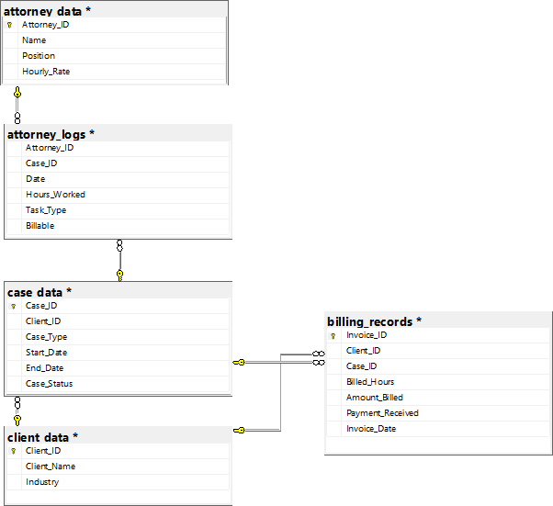
Dataset Overview
attorney_data.csv
Attorney details including role, total hours worked, and billing rates
client_data.csv
Client profiles and industries served
attorney_logs.csv
Task-level time tracking across case types (e.g., drafting, court appearance)
case_data.csv
Metadata including case type, status, industry, and duration
billing_records.csv
Billing amounts, payments received, and invoice history

Slide 4
Key Metrics & Formulas
Utilization Rate
Collection Rate
Billable Hours / Total Hours
Payment Received / Amount Billed
Realization Rate
Case Duration
Billed Hours / Logged Hours
End Date - Start Date

Slide 5

Task Duration Analysis
25.8%
22.1%
Research
Court Appearance
18.0%
17.6%
Review
Client Call
16.4%
Drafting
Insight: Research and Court Appearances consume the majority of attorney time.

Slide 6
Case Type Distribution
35%
34%
16%
15%
Criminal
Intellectual Property
Corporate
Civil
Insight: Criminal and IP cases dominate the firm’s caseload

Slide 7
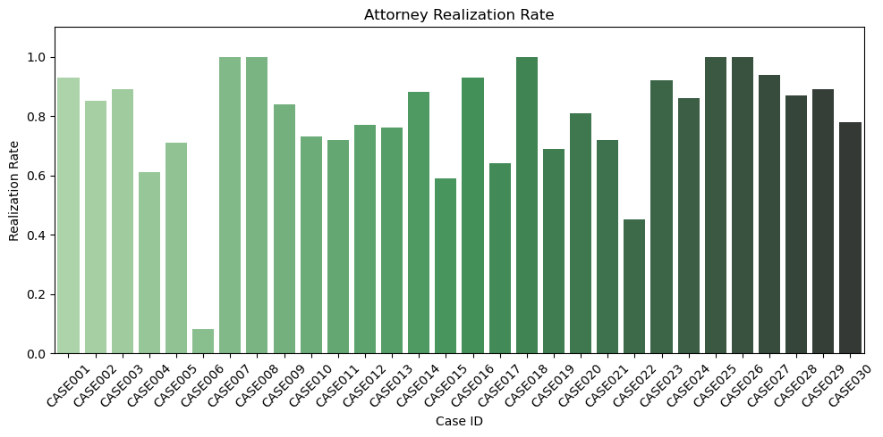
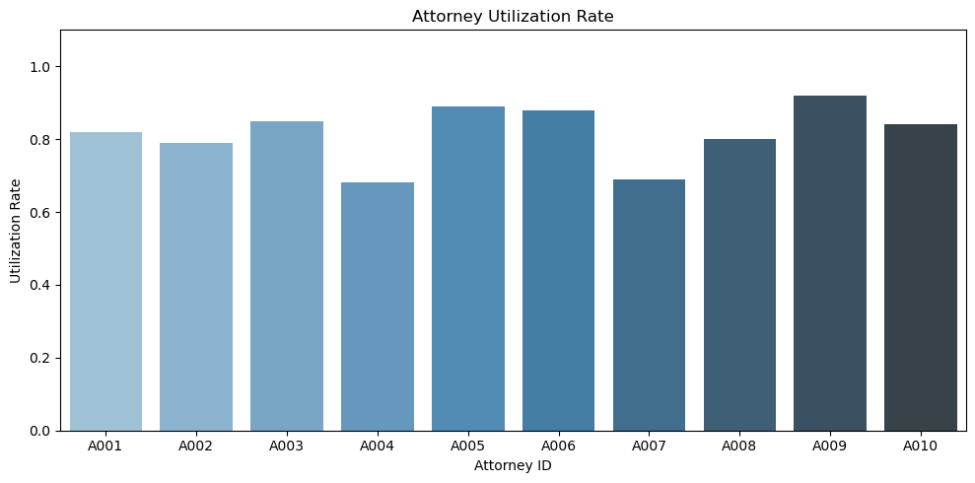
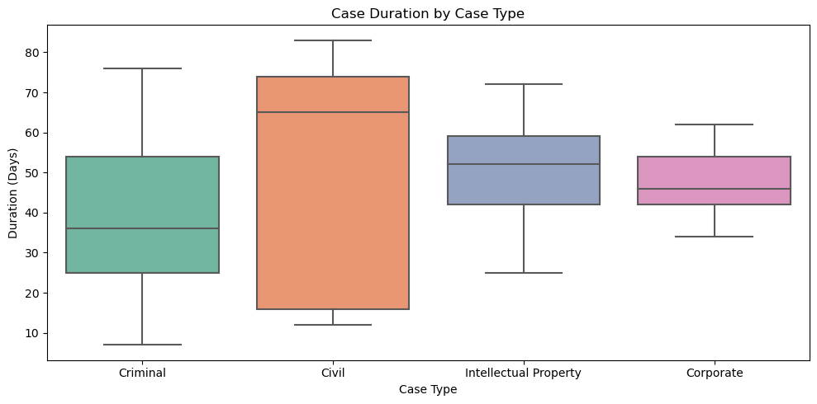
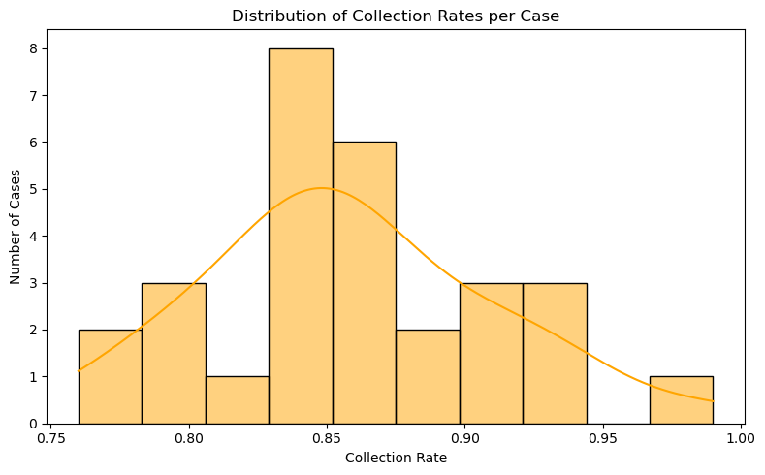
Case Type Distribution
Insight: High Utilization tends to lead to high Realization and Collections

Slide 8
Recomendations
Identify underperforming tasks and underutilized attorneys
Automate time tracking to improve accuracy
01
02
04
Develop client dashboards for transparency
Focus on high-ROI case types (e.g., IP)
03

Slide 9
Future Enhancements
Feedback Scorecard
ML & AI
Dashboards
Integrate client satisfaction scores
Predict case duration using ML
Build real-time dashboards using Tableau/Power BI

Slide 10
Questions?
Thank you for your time

